Slide 1
Disorders of lipoprotein metabolism
Dr Praveen R V

Slide 2
Lipid structure and metabolism
Lipids constitute approximately 70% (by mass) of the dry weight of plasma.
Approximately half of circulating lipids are sterols, with the other major components being phospholipids and triglycerides, which circulate in lipoproteins.

Slide 3
3 main biological classes of lipids
TAG
Phospholipids
Cholesterol
Combines with apolipoproteins to form lipoproteins

Slide 4
Lipoprotein structure
Lipoproteins are large macromolecular complexes composed of lipids and proteins.
Notes:
Here is a diagramatic representation of a lipoprotein.
Plasma lipoproteins are spherical particles containing a hydrophobic core composed predominately of triglyceride and / or cholesterol esters and a surface coat whose primary component is a phopholipid monolayer. Interspersed in the phopholipid coat are free cholesterol and apolipoproteins.
(Apoproteins are the protein portion of the lipoproteins)

Slide 5
1st layer – TAG + cholesterol esters (hydrophobic)
2nd layer –cholesterol+phospholipids(amphipathic)
3rd layer – apolipoproteins (hydrophilic)

Slide 6
Apolipoprotein classes

Slide 7
Apolipoproteins - functions
Structural proteins in lipoproteins.
Negotiate the hydrophobic, insoluble lipids in plasma.
They activate enzymes in lipoprotein metabolism.
Act as ligands for cell surface receptors.

Slide 8
Biologically important lipoproteins
Chylomicrons
VLDL
LDL
HDL

Slide 11
Chylomicrons
Carry dietary TAG to peripheral tissues
Dietary TAG are hydrolysed by lipase into FFA and glycerol
Micelle formation- FFA + glycerol+ ditary cholesterol + fat soluble vitamins+ bile salts
Micelle cross the water layer and reaches enterocytes

Slide 12
Chylomicrons formation in enterocytes
Chylomicron contains TAG + cholesterol esters + phospholipids+ apolipoproteins
Nascent chylomicron – apoA & apoB-48
Nascent chylomicrons are absorbed into intestinal lymphatics
Matured in lymphatics by auquiring apoCII from circulating HDL-C and apoE.

Slide 13
In periphery chylomicrons are extensively processed by peripheral tissues before reaching the liver.
The particles encounter lipoprotein lipase (LPL), which is anchored to a protein( GPIHBP1) that is attached to the endothelial surfaces of capillaries in adipose tissue, heart, and skeletal muscle.
The triglycerides of chylomicrons are hydrolyzed by LPL, and free fatty acids are released.

Slide 14
ApoC-II – co factor for LPL
The released free fatty acids are taken up by adjacent myocytes or adipocytes and either oxidized to generate energy or reesterified and stored as triglyceride.
The chylomicron particle progressively shrinks in size as the hydrophobic core is hydrolyzed and the hydrophilic lipids (cholesterol and phospholipids) and apolipoproteins on the particle surface are transferred to HDL, creating chylomicron remnants.

Slide 15
Chylomicron remnants are rapidly removed from the circulation by the liver through a process that requires apoE as a ligand for receptors in the liver.
So no chylomicrons or chylomicron remnants are generally present in the blood after a 12-h fast, except in patients with certain disorders of lipoprotein metabolism.

Slide 16
Hepatically derived lipid –VLDL & LDL
VLDL – composition similar to chylomicron
contain apoB-100 instead of apoB-48(nascent VLDL)
Packaging recquires microsomal transfer protein (MTP)
Get matured by acquiring apoCII & apoE, in circulation
As with chylomicrons, the triglycerides of VLDL are hydrolyzed by LPL, especially in muscle, heart, and adipose tissue.

Slide 17
After the VLDL remnants dissociate from LPL, they are referred to as IDLs, which contain roughly similar amounts of cholesterol and triglyceride.
The liver removes approximately 40–60% of IDL by LDL receptor–mediated endocytosis via binding to apoE.
The remainder of IDL is remodeled by hepatic lipase (HL) to form LDL.

Slide 18
During this process, phospholipids and triglyceride in the particle are hydrolyzed, and all apolipoproteins except apoB-100 are transferred to other lipoproteins.
Approximately 70% of LDL is removed from the circulation by the liver in a similar manner as IDL; however, in this case, apoB, rather than apoE, binds the LDL receptor

Slide 20
HDL Metabolism and Reverse Cholesterol Transport
it carries cholesterol from extra hepatic tissues to liver
Synthesized in liver and intestine – discoidal shape
Acquires apoAI
ABCA1 & ABCG1 present on cell membrane transport cholesterol to HDL-C .
HDL transfer cholesterol and triglycerides between VLDL,IDL through cholesteryl ester transfer protein (CEPT).

Slide 21
LCAT –plasma enzyme –esterifies the cholesterol and it gives a spherical shape to HDL-C. this shape facilitates movement through capillaries
HDL-C is then taken up by SRB1 (scavenger receptor 1) on liver
The cholesterol is then used up for the synthesis of bile acids and excreted out

Slide 23
Classification - hyperlipidemia
Primary -defect in genes and /or enzymes involved in lipoprotein metabolism
Secondary- diet, exercise, addictions ,hormonal changes, nephrotic syndrome, metabolic syndrome..

Slide 24
The original classification of lipoprotein disorders by Fredrickson, Lees, and Levy (1967).
It was based on measurement of total plasma cholesterol and triglycerides
Analysis of lipoprotein patterns after separation by electrophoresis.

Slide 25
Primary hyperlipidemia – Fredrickson classification
Notes:
Fredrickson and Levy classified hyperlipoproteinemias according to the type of lipoprotein particles that accumulate in the blood (Type I to Type V)

Slide 27
Despite providing a useful conceptual framework this classification has many drawbacks
It does not include HDL-C
It does not differentiate severe monogenic lipoprotein disorders from the more common polygenic disorders.

Slide 28
Alternative classifications
Primary Disorders of Elevated ApoB -Containing Lipoproteins{VLDL,IDL,LDL,Lp(a)}
Inherited Causes of Low Levels of ApoB -Containing Lipoproteins
Genetic Disorders of HDL Metabolism
Miscellaneous-
Elevated Plasma Levels of Lipoprotein(a)
Elevated small dense LDL particles
Notes:
Important from treatment point of view
Effective patient management

Slide 29
Lipid disorders associated with elevated LDL and normal triglycerides
Familial Hypercholesterolemia (FH)
Familial Defective ApoB-100 (FDB)
Autosomal Dominant Hypercholesterolemia Due to Mutations in Pcsk9 (ADH-Pcsk9 or ADH3)
Autosomal Recessive Hypercholesterolemia (ARH)
Sitosterolemia
Polygenic Hypercholesterolemia

Slide 30
Familial hypercholesterolemia
Autosomal codominant disorder
Elevated plasma levels of LDL-C
Triglyceride level-normal
Premature coronary atherosclerosis
Pathophysiology -Defect in LDL receptor(ADH-1)
More than 1600 different mutations have been reported in association with FH.
Homozygous (<1/1000000) and heterozygous(1/250)
Receptor negative : < 2% LDL receptor activity
Receptor defective: 2-25% receptor activity

Slide 31
Familial hypercholesterolemia
Tendon xanthomas-hands,wrists,elbows,knees,heels or buttocks
Total cholesterol levels: HeFH/HoFH→350- 550/650-1000 mg/dl
Total LDL-C levels :HeFH/HoFH→200-400/>600mg/dl
Accelerated atherosclerosis – begins in aortic root and extends into coronary ostia
Receptor negative-untreated patients don’t survive beyond 2nd decade
Receptor defective- better prognosis

Slide 32
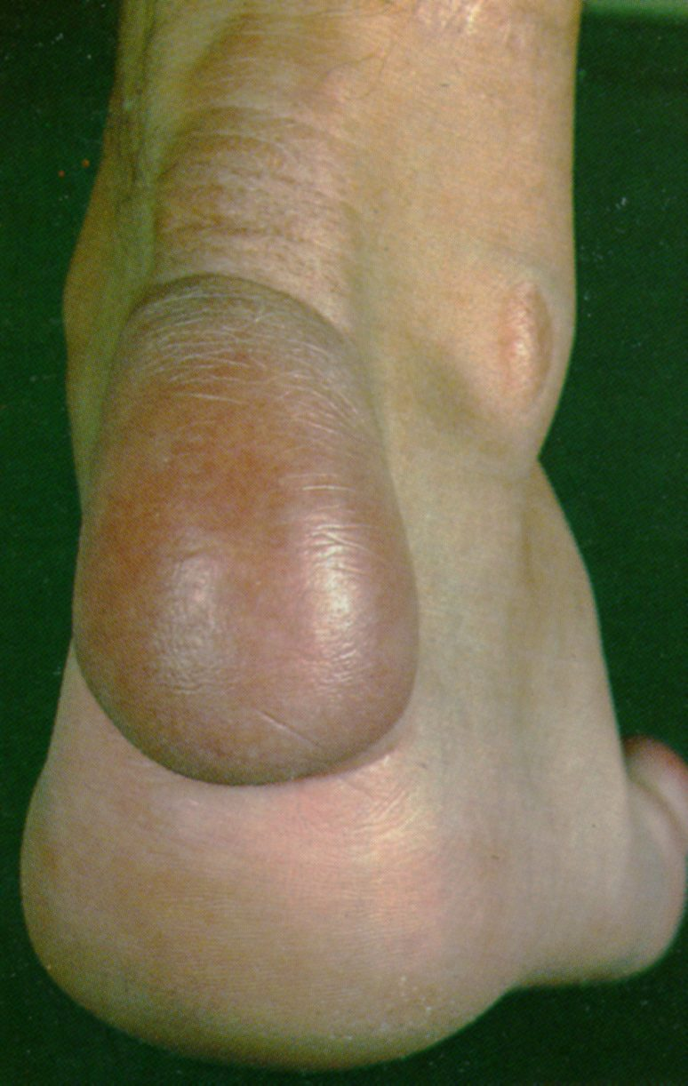
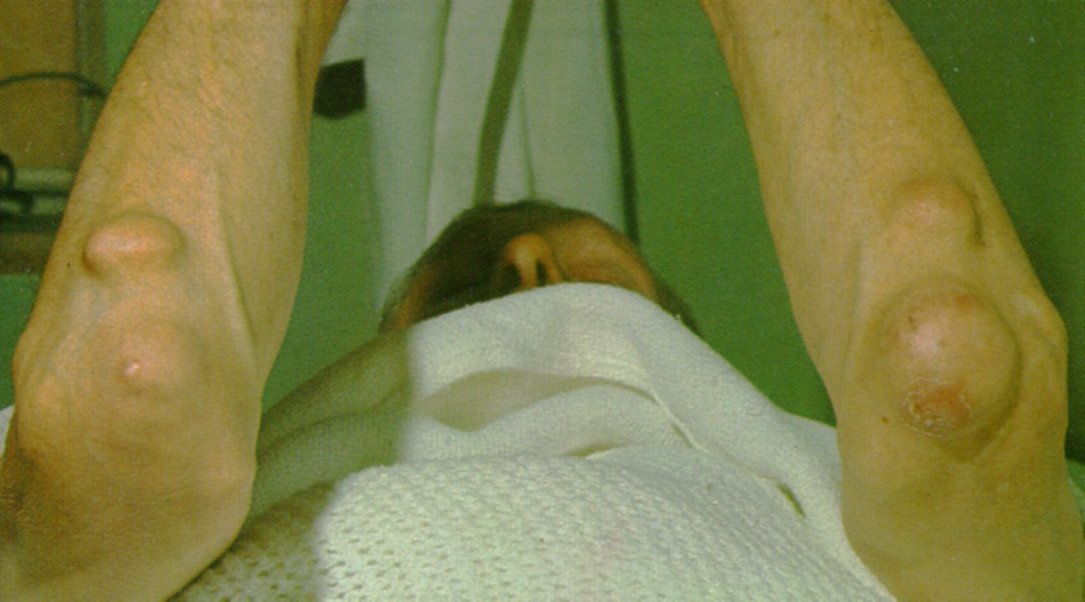
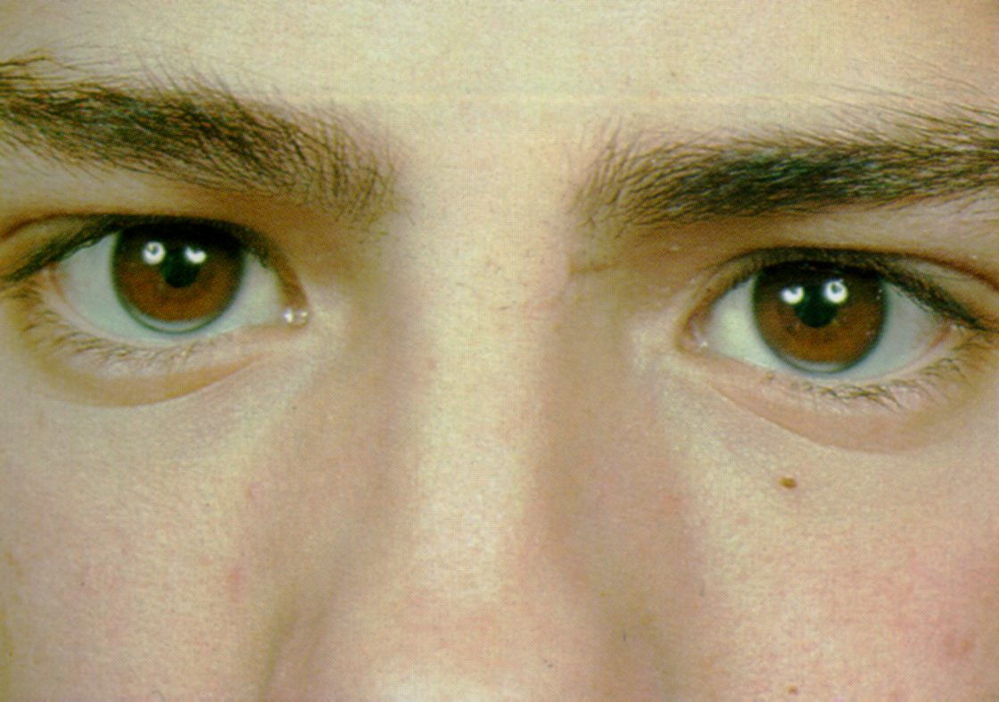

Slide 33
In HeFH, CAD develops in about 50% of males by the age of 50yrs and 30% of females by 60yr.
No specific diagnostic test.
Screening in target population was the initial method but changed to “cascade screening”.
Cascade screening- first and second degree relatives of diagnosed patients.
Various clinical criterias for diagnosis FH have been proposed.

Slide 34
Simon Broome criteria-UK
POSSIBLE | PROBABLE | DEFINITE
Total-cholesterol (LDL-C) in mg/dl >260(155) in patients with age <18 years and >290 (190) in patients >18 years F/H of elevated total-C >290 mg/dl in first or second degree relative or F/H of CAD at age <60 years in 1st degree relative or <50 years in 2nd degree relative | Total-cholesterol (LDL-C) in mg/dl >260(155) in patients with age <18 years and >290 (190) in patients >18 years Tendon xanthomas in the patient or in first/2nd degree relative | Total-cholesterol (LDL-C) in mg/dl >260(155) in patients with age <18 years and >290 (190) in patients >18 years DNA mutation consistent with FH

Slide 35
MEDPED criteria-USA
87%- sensitivity
98%- specificity

Slide 36
Dutch Lipid Clinic criteria

Slide 37
Screening of FH recommendations by US National Lipid association
Universal screening for elevated LDL-C or non-HDL-C is recommended.
FH should be suspected if children, adolescents, or young adults <20 years of age has LDL-C ≥160 mg/dl or non-HDL-C ≥190 mg/dl
LDL-C >190 in < 20 yr old group : 80% is Dx in general population screening.
F/H of elevated cholesterol/premature CAD among 1st degree relatives should be collected from the above mentioned group.
Positive family history increases the likelihood of diagnosis of FH
All individuals should be screened before the age of 20 years.
Screening should be considered beginning at the age of 2 years for children with family history of elevated cholesterol or premature coronary artery disease.
Tendon xanthoma at any age, arcus corneae at the age <45 years and xanthelasma at the age <25 years strongly suggest FH.

Slide 38
Familial Defective Apo-B-100 (FDB)
Dominantly inherited disorder (ADH type-2),less common than FH
Mutations in the LDL receptor–binding domain of apoB-100 is the defect.
LDL binds the receptor with reduced affinity -> removed from the circulation at a reduced rate
Clinically identical to HeFH but have lower plasma levels of LDL.
IDL clearance is not affected as IDL is cleared through Apo- E.

Slide 39
Autosomal Dominant Hypercholesterolemia -3
ADH –type 3 is a very rare autosomal dominant disorder caused by gain-of-function mutations in proprotein convertase subtilisin/kexin type 9 (PCSK9)
PCSK9 is a secreted protein that binds to the LDL receptor causing its degradation.
So gain of function mutation causes depletion in hepatic LDL-Receptor and LDL clearance reduced.
ADH –type 3 is indistinguishable clinically from patients with FH.
They may be particularly responsive to PCSK9 inhibitors like Alirocumab, Evolocumab.

Slide 41
Autosomal Recessive Hypercholesterolemia (ARH)
LDL Receptor Adaptor Protein (LDLRAP) is involved in LDL receptor–mediated endocytosis in the liver.
In the absence of LDLRAP, lipoprotein-receptor complex fails to be internalized.
Clinically resembles HoFH -Hypercholesterolemia, tendon xanthomas, premature CAD.
Hyperlipidemia responds partially to treatment with HMG-CoA reductase inhibitors
Usually require LDL apheresis to lower plasma LDL-C.
Notes:
LDL Receptor adaptor protein (LDLRAP)

Slide 42
Sitosterolemia
Rare Autosomal recessive disease.
It is caused by mutations in either of two members of the ATP-binding cassette (ABC) half transporter family, ABCG5 and ABCG8.
These genes are expressed in enterocytes and hepatocytes and are concerned with excretion of plant sterols across the membrane.
Due to this the hepatic & plasma level of plant sterols (sitosterol and campesterol) are increased and they down regulate the LDL –R in liver there by increasing the LDL-C.
Clinically-Severe hypercholesterolemia, tendon xanthomas, premature ASCVD (Atherosclerotic CardioVascular Disease)

Slide 43
Sitosterolemia
Anisocytosis and poikilocytosis of erythrocytes and megathrombocytes due to the incorporation of plant sterols into cell membranes.
Episodes of hemolysis and splenomegaly are a distinctive clinical feature and can be a clue to the diagnosis.
Sitosterolemia should be suspected
In a patient with severe hypercholesterolemia without a family history.
who responds dramatically to dietary therapy and/or ezetimibe/bile acid sequestrants but not statins.

Slide 44
Polygenic Hypercholesterolemia
Elevated LDL with a normal plasma level of triglyceride in the absence of secondary causes of hypercholesterolemia
Plasma LDL levels are generally not as elevated as they are in other primary hypercholesterolemias
Only <10% of fist degree relatives of patients with polygenic hypercholesterolemia have hypercholesterolemia.
Inheritance of several variants that together elevate LDLC, coupled with diet, is generally the cause of this condition
Notes:
One-half of the first-degree relatives of patients with FH and FDB are hypercholesterolemic, whereas <10% of first-degree relatives of patients with polygenic hypercholesterolemia have hypercholesterolemia
Treatment of polygenic hypercholesterolemia is identical to that of other forms of hypercholesterolemia

Slide 45
Lipoprotein(a)
Lp(a) (pronounced “lipoprotein little a”) consists of an LDL particle linked covalently with one molecule of apo (a).
The apo (a) moiety consists of a protein with a high degree of homology with plasminogen.
Apo (a) gene -6q26-27.
Several isoform, and the isoform with low molecular weight are more atherogenic.
The level of Lp(a) in a individual is completely genetically determined.
Higher conc. Seen in Africans, Asian have moderate level.
According to European Atherosclerosis Society(EAS) desirable level is <14mg/dl; >30 high risk.

Slide 46
Lipoprotein(a)
The Copenhagen City Heart Study- Lp(a)>50mg/dl →2-3 fold increased risk of MI.
Emerging Risk factor Collaborator data (n-133502)-Lp(a) reclassify 4.1% to high risk group.
The Bruneck study-(15yr prospective) predicts 15 years CVD outcome and improves CVD risk prediction
Meta analysis of Erqou et al did not show linear association between Lp(a) level and coronay risk.
The INTERHEART study also not showed association.

Slide 47
Lipoprotein(a)
EAS guidelines on Lp(a) measurement
Premature CVD
Intermediate-high risk FH
F/H of premature CVD/increasd Lp(a) level
Recurrent CVD despite statins
If >3% 10yr risk of fatal CVD by European guidelines
Treatment of choice- Niacin
But no clinical trial evidence that supports a benefit for lowering Lp(a).

Slide 48
Elevated small dense LDL particles
Associated with 3 fold ↑risk of CAD.
Low vitamin –E level
Increased sensitivity for oxidation
Easily enters vessel wall and initiate atherosclerosis
sd LDL has lower affinity to bind to LDL-R.
Higher conc. in insulin resistance.
Increase in sd LDL is called B pattern.
Life style modification and diabetic control can reverse LDL pattern from bad B pattern to good A pattern.
New concept is the number and size of LDL is more important than the plasma conc.

Slide 51
Combined dyslipedemia
Familial Combined Hyperlipidemia -FCHL (Type IIb Hyperlipoproteinemia)
Familial Dysbetalipoproteinemia –FDBL (Type III Hyperlipoproteinemia)
Hepatic Lipase Deficiency

Slide 52
Familial Combined Hyperlipidemia (FCHL)
Polygenic combined hyperlipidemia, incidence 1in 100-200.
The molecular etiology of this condition remains poorly understood.
Important cause of premature CAD
Approximately 20% of patients who develop CAD under age 60 have FCHL.
One of three phenotypes
Elevated plasma levels of LDL-C (200-400mg/dl) with low HDL-C.
Elevated plasma levels of triglycerides (200-600mg/dl)due to elevation in VLDL
Elevated plasma levels of both LDL-C and triglyceride
Classical feature of FCHL -lipoprotein profile can switch among these three phenotypes in the same individual over time
Disproportionate elevation in Apo-B relative to the plasma LDL-C ,due to small, dense LDL particles, is characteristic. (LDL-C/Apo-B=<1.2)
Family history of hyperlipidemia and/or premature CHD
Notes:
The presence of a mixed dyslipidemia
Plasma triglyceride levels between 200 and 800 mg/dL
Total cholesterol levels between 200 and 400 mg/dL
HDL-C levels <40 mg/dL in men and <50 mg/dL in women

Slide 53
Familial Dysbetalipoproteinemia –FDBL (Type III Hyperlipoproteinemia)
Mixed hyperlipidemia due to the accumulation of remnant lipoprotein particles (chylomicron remnants and VLDL remnants, or IDL).
Due to genetic variations in apoE isoforms
Patients homozygous for the E2 allele (the E2/E2 genotype) comprise the most common subset of patients with FDBL
The plasma levels of cholesterol and TG are often elevated to a similar degree.
Precipitating factors usually present (high-fat diet, diabetes mellitus, obesity, hypothyroidism, renal disease, HIV infection, estrogen deficiency, alcohol use, drugs)
Notes:
high-fat diet, diabetes mellitus, obesity, hypothyroidism, renal disease, HIV infection, estrogen deficiency, alcohol use, drugs

Slide 54
Familial Dysbetalipoproteinemia (Type III Hyperlipoproteinemia)
Hyperlipidemia, xanthomas, premature CAD or PAD.
Two pathagnomonic types of xanthomas- tuberoeruptive and palmar, are seen in FDBL patients.( xanthomata striata palmaris)
The ratio of directly measured VLDL-C to total plasma TG >0.30.
The disease seldom presents in women before menopause
Broad beta band on electrophoresis
Dramatic response to weight reduction and dietary changes; statins
Treatment of other metabolic conditions
Notes:
Palmar xanthomas (alternatively called xanthomata striata palmaris) are orange-yellow discolorations of the creases in the palms and wrists
In FDBL, in contrast to other disorders of elevated triglycerides, the plasma levels of cholesterol and triglyceride are often elevated to a similar degree and the level of HDL-C is usually normal rather than being low

Slide 56
Hepatic Lipase Deficiency
Autosomal recessive disorder, very rare
Elevated plasma levels of cholesterol and triglycerides (mixed hyperlipidemia) due to the accumulation of circulating lipoprotein remnants.
Association of this genetic defect with ASCVD is not clearly known.
Lipid-lowering therapy with statins along with other drugs.
Notes:
and either a normal or elevated plasma level of HDL-C

Slide 57
Lipid Disorders Associated with Elevated Triglycerides
Familial Chylomicronemia Syndrome (Type I Hyperlipoproteinemia; Lipoprotein Lipase and ApoC-II Deficiency)
Familial Hypertriglyceridemia (Type IV &V)
Apo A-V Deficiency
GPIHBP1 Deficiency

Slide 58
Familial Chylomicronemia Syndrome
LPL (Lipoprotein Lipase) is required for the hydrolysis of triglycerides in chylomicrons and VLDLs
ApoC-II is a cofactor for LPL.
Genetic deficiency or inactivity of LPL or apo C II results in impaired lipolysis and elevations in plasma chylomicrons.
The fasting plasma is turbid.
Fasting TG levels are almost invariably >1000 mg/dL.
IV heparin injection - endothelial-bound LPL is released
LPL activity is profoundly reduced in both LPL and apo C-II deficiency
Normalizes after the addition of normal plasma (providing a source of apoC-II)

Slide 59
Familial Chylomicronemia Syndrome
Very rare, AR in inheritance
Recurrent abdominal pain in childhood –acute pancreatitis.
Lipemia retinalis, Eruptive xanthomas- small, yellowishwhite papules, often appear in clusters on the back, buttocks, and extensor surfaces of the arms and legs.
Premature CHD is not generally a feature of familial chylomicronemia syndromes.
Hepatosplenomegaly may be seen

Slide 61
Familial chylomicronemia syndrome
TREATMENT
Dietary fat restriction with fat-soluble vitamin supplementation
Medium-chain triglycerides
Fish oils,Fresh frozen plasma – source of apo C
Plasmapheresis in pregnancy &Gene therapy-alipogene tiparvovec is approved.

Slide 62
Familial Hypertriglyceridemia (FHTG)
Polygenic hypertriglyceridemia.
Plasma LDL-C levels are generally not increased and are often reduced due to defective metabolism of the triglyceride-rich particles.
The diagnosis of FHTG is suggested by the triad of
Elevated levels of plasma triglycerides (250–1000 mg/dL)
Normal or only mildly increased cholesterol levels (<250 mg/dL)
Reduced plasma levels of HDL-C
Secondary factors are to be ruled out first.
VLDL is elevated & Unlike FCHL Apo B levels not elevated
There is no increased risk of CAD but pancreatitis risk is there

Slide 63
HYPERTRIGLYCERIDEMIA - OTHER CAUSES
APO A V DEFICIENCY
Apo A-V required for the association of VLDL and chylomicrons with LPL
Deficiency presents as hyperchylomicronemia
GPIHBP1 Deficiency
LPL is attached to a protein on the endothelial surface of capillaries called GPIHBP1
Mutations that interfere with GPIHBP1 synthesis or folding cause severe hypertriglyceridemia

Slide 64
Inherited Causes of Low Levels of Apo B Containing Lipoproteins
Familial Hypobetalipoproteinemia (FHB)
Most common inherited form of hypocholesterolemia
Low total cholesterol and LDL-C due to mutations in apoB
LDL levels < 80 mg%.
Protection from CHD.
Parents have abnormal lipid fractions.

Slide 65
PCSK9 Deficiency
Loss of function mutations
PCSK9 normally promotes the degradation of the LDL receptor
Absence cause increased activity of LDL receptor and low LDL levels ( 40% reduction)
Protection from CHD increases as plasma LDL levels decrease
Notes:
Phenocopy of FHB

Slide 66
Abetalipoproteinemia
AR disorder due to loss-of-function mutations in the gene encoding microsomal triglyceride transfer protein (MTP)
MTP -transfers lipids to nascent chylomicrons and VLDLs in the intestine and liver
Parents have normal lipid levels
Diarrhea and failure to thrive
Neurologic manifestations
Pigmented retinopathy -defective absorption and transport of fat soluble vitamins – vitamin E
Low-fat, high-caloric, vitamin-enriched diet

Slide 67
Genetic Disorders of HDL Metabolism
Inherited causes of low levels of HDL-C
Gene Deletions in the Apo A V-AI-CIII-AIV Locus and Coding Mutations in ApoA-I
Tangier Disease (ABCA1 Deficiency)
LCAT Deficiency
Primary Hypoalphalipoproteinemia
Inherited causes of high levels of HDL-C
CETP Deficiency

Slide 68
Gene Deletions in the ApoAV-AI-CIII-AIV Locus and Coding Mutations in ApoA-I
Absence of mature HDL
Free cholesterol increase in HDL and in tissues
Corneal opacities and planar xanthomas
Premature CHD

Slide 69
Tangier Disease (ABCA1 Deficiency)
Autosomal recessive
ABCA1, a cellular transporter that facilitates efflux of unesterified cholesterol and phospholipids from cells to apoA-I
Extremely low circulating plasma levels of HDL-C (<5 mg/dL) and apoA-I (<5 mg/dL).
Hepatosplenomegaly, pathognomonic enlarged grayish yellow or orange tonsils, mononeuritis multiplex
Premature CHD not so common – because LDL levels also low

Slide 70
LCAT Deficiency
Autosomal recessive
Defective formation of mature HDL
Low levels of HDL
2 types – complete (Classic)and partial( Fish-eye disease)
Progressive corneal opacification -charcteristic
Fish eye disease has no other sequelae.
Complete form – hemolytic anemia, progressive renal insufficiency and ESRD
Premature CAD not seen

Slide 71
Primary Hypoalphalipoproteinemia (Isolated low HDL Syndrome)
Defined as a plasma HDL-C level below the tenth percentile in the setting of relatively normal cholesterol and triglyceride level
No apparent secondary causes of low plasma HDL-C
No clinical signs of LCAT deficiency or Tangier disease.
Premature CHD not a consistent feature
Notes:
Premature CHD depends on gene defect and other underlying metabolic defects

Slide 72
Inherited causes of high levels of HDL-C
CETP DEFICIENCY
Loss-of-function mutations
CETP facilitates transfer of cholesteryl esters from HDL to apoB-containing lipoproteins
CETP deficiency results in an increase in the cholesteryl ester content of HDL,decreased clearance of HDL and a reduction in plasma levels of LDL-C
The relationship of CETP deficiency to ASCVD remains unresolved

Slide 73
TREATMENT
Lifestyle changes
Drugs
Lipoprotein apheresis
Gene therapy

Slide 74
NO more diet control Exercise recommendation
Exercise→ Recommended target for improvements in blood lipid profile is minimum of 1,000 kcal/week.
Strategy is to maximize energy expenditure
Mode- Aerobic exercise.
Intensity- should be between 40-70% of VO2 Reserve or Heart Rate Reserve.
Frequency and Duration--30-60 minutes, at least 5 times per week.

Slide 75
Life style modification
Physical activity
Limitation of alcohol intake
Total avoidance of tobacco products
Low calorie diet with a total fat intake of ≤3% of the total dietary intake
<8% of saturated fat
<75 mg/1,000 kcal cholesterol for these patients

Slide 76
Treatment of HoFH
LDL apheresis combined with maximum tolerated potent statins, ezetimibe and bile acid sequestrants.
Apheresis should start in early childhood after initiation of drug treatment.

Slide 77
LDL apheresis
In HoFH, hyperLp(a)
Does once in two week
Indication
Pts with max tolerated drug therapy and have CAD and LDL-C >200mg/dl.
No CAD wit plasma LDL-C >300mg/dl

Slide 78
Inhibitors of LDL synthesis, lomitapide and mipomersen, are new therapeutic options. PCSK9 inhibitors are being evaluated in HoFH and seem to be effective if there is residual receptor activity.

Slide 79
Lomitapide
Approved for the treatment of HoFH
US FDA approved lomitapide on 21 December 2012.
It is an orphan drug.
MOA- Microsomal triglyceride transfer protein inhibitor(MTP inhibitor)
↓LDL-C by 50% and prevent VLDL formation and secretion from liver.
↑ALT level and fatty liver.

Slide 80
Mipomersen
Mipomersen inhibit apo B mRNA with phosphorothioate-linked antisense oligonucleotides.
Approved for HoFH.
↓LDL-C by 20-30%.
S.E-Associated with fat deposition in the liver

Slide 81
Statins
Statins- inhibitors of HMG-CoA reductase and prevent the formation of mevalonate, the rate-limiting step of sterol synthesis.
Increases hepatic LDL –R and decrease the production of VLDL and LDL.
Statins may increase HDL-C.
Statins decrease the inflammatory component of plaque.
Statins ↑Trans Intestinal Cholesterol Excretion(TICE).
S.E- Myalgia(10%),myositis(↑CPK, need rechallenge to confirm),rhabdomyolysis(rare),reversible elevation of ALT.
Check ALT and CPK within 3months.
Usually well tolerated.

Slide 82
High intensity - Daily dosage lowers LDL-C by approximately ≥ 50% on average
Moderate intensity -Daily dosage lowers LDL-C by approximately 30% to 50% on average
Low intensity -Daily dosage lowers LDL-C by < 30% average.
Statins are first line treatment option in almost all condition with hypercholesterolemia( primary /secondary).

Slide 84
Ezetimibe
Ezetimibe limits selective uptake of cholesterol and other sterols by intestinal epithelial cells by interfering with NPC1L1 (Niemann–Pick C1–like 1).
Usual second line agent, Dose 10 mg
Ezetimibe lowers LDL-C by about 18% and adds to the effect of statins.
Drug of choice in cases of sitosterolemia.
Ezetimibe trials-ENHANCE,SEAS,ARBITER-6,SHARP & IMPROVE-IT

Slide 85
Fibrates
Indicated for hypertriglyceridemia and in the secondary prevention of CVD in patients with low HDL-C levels.
Gemfibrozil 600mg BD, Fenofibrate 200mg OD.
MOA-interact with PPAR-α, which regulates transcription of the LPL, apo C-II, and apo A-I genes.
S.E-cutaneous manifestations,abdominal discomfort, increased bile lithogenicity, erectile dysfunction, elevated transaminase levels, interaction with oral anticoagulants, and elevated plasma homocysteine.
In post statin era the FIELD and ACCORD trials have failed to achieve clinical usefulness of fibrates.

Slide 86
Bile Acid Sequestrant
Interrupt the enterohepatic circulation of bile acids by inhibiting their reabsorption.
Used as adjunctive therapy
Not absorbed systemically, safest
Cholestyramine - 4-g unit doses as a powder
Colestipol is used in 5-g unit doses.
Colesevelam is more potent,twice the capacity to bind cholesterol as cholestyramine does.( In doses of 3.8 to 4.5 g/day)
Colesevelam decrease glycated hemoglobin A1c (HbA1c).
Taken with food, other medication 1hr b/f or 4hr after only.
S.E- constipation, a sensation of fullness, and gastrointestinal discomfort.
Can cause hypertriglyceridemia.

Slide 87
Nicotinic acid
Niacin ↑HDL-C,↓ TG levels & ↓VLDL production.
Modest effects on LDL levels.
Doses- 2000 to 3000 mg/day TID.
S.E-Skin flushing, attenuated by aspirin & prostaglandin D2 receptor antagonist laropiprant.
Other S.E- Hyperuricemia, Hyperglycemia, Hepatotoxicity, Acanthosis nigricans, and gastritis.
The mechanism of action of niacin remains unsettled.
Large clinical trials do not support the ability of niacin therapy to improve cardiovascular outcomes in patients receiving statins.

Slide 88
PCSK9 inhibitors
Monoclonal antibodies that inhibit proprotein convertase subtilisin–kexin type 9 (PCSK9) have emerged as a new class of drugs that effectively lower LDL cholesterol levels.
Evolocumab, alirocumab.
Injectables 2weekly or monthly
Can reduce LDL –C upto 60% from baselines.
Trials supporting GAUSS-2, RUTHERFORD-2, LAPLACE-2, DESCARTES, and TESLA Part B
The latest is FOURIER Trial -2017

Slide 89
CETP inhibitors
Cholesteryl Ester Transfer Protein Inhibitors
↑HDL-C (138%) and ↓LDL-C (40%)
Torcetrapid →ILLUMINATE trial-proved toxic and increased mortality hence abandoned.
Dalcetrapid→dal-OUTCOMES trial-found ineffective.
Anacetrapib
DEFINE trial- phase II clinical trial good results.
REVEAL trial – use of anacetrapib in those receiving intensive statin therapy resulted in lower incidence of major coronary events
Evacetrapib →ACCELERATE trial-not a/w lower rate of cardiovascular events than placebo

Slide 90
Gene therapy
In patients with HoFH initial trials were not successful.
But it is found to be effective in
Abetalipoproteinemia,
LPL deficiency,
Niemann-Pick type C disease,
Sitosterolemia,
Tangier disease.

Slide 91
THANK YOU

